Slide 1

Q8 – HW3
Alireza Abbasi - 403616204

Slide 2
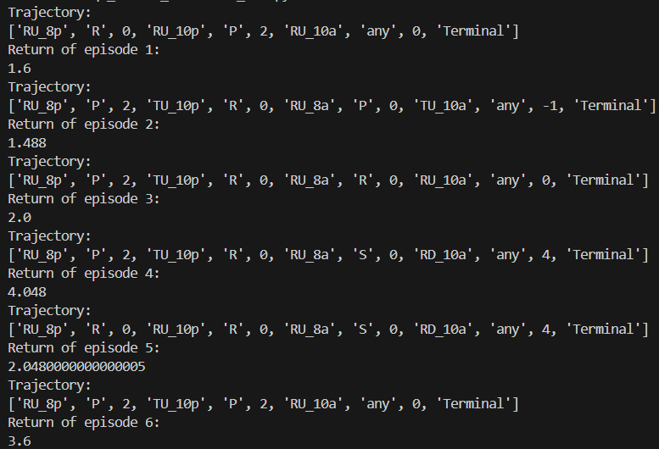
First 6 episode Trajectories

Slide 3

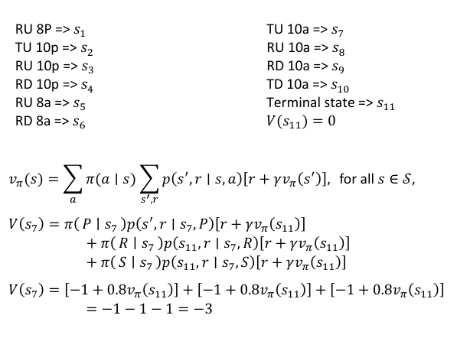
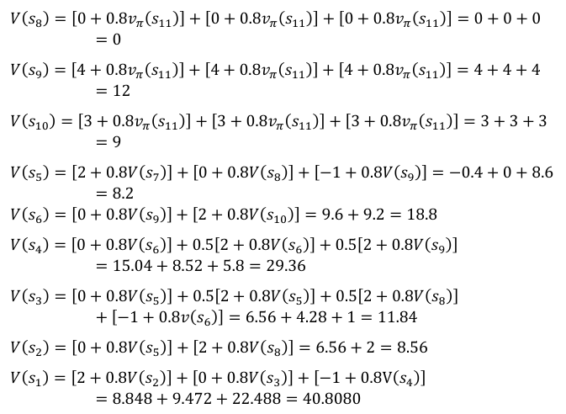
Mean return after 50 episodes
Manually calculating values:

